Slide 1

EMPLOYEE MANAGEMENT SYSTEM

Slide 2

INTRUDCTION

Slide 3

Photo Album
by HP

Slide 4
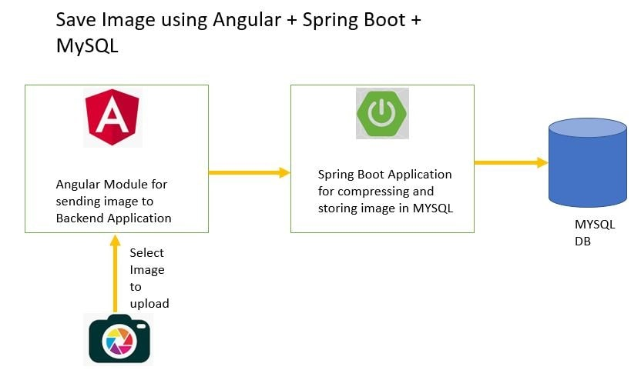

Slide 5
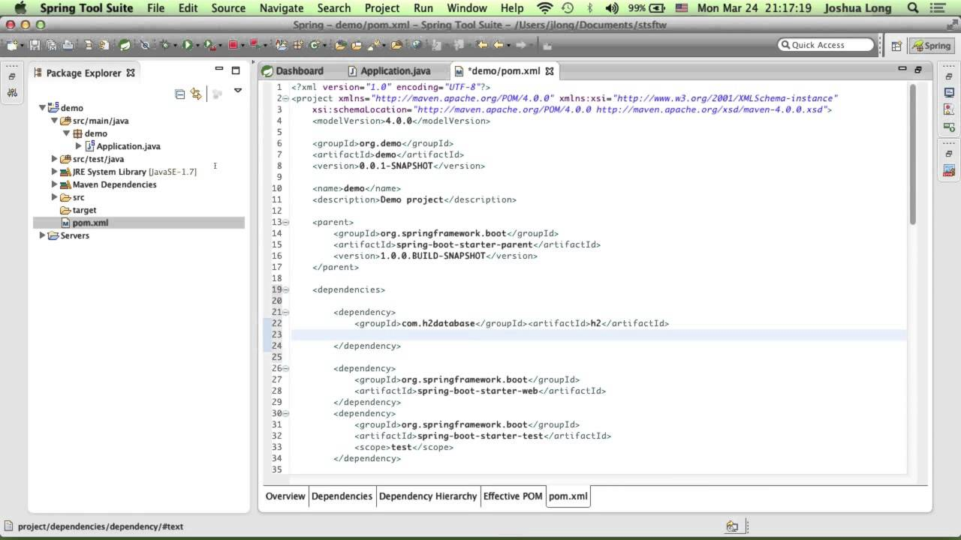
SPRING BOOT CODE

Slide 6
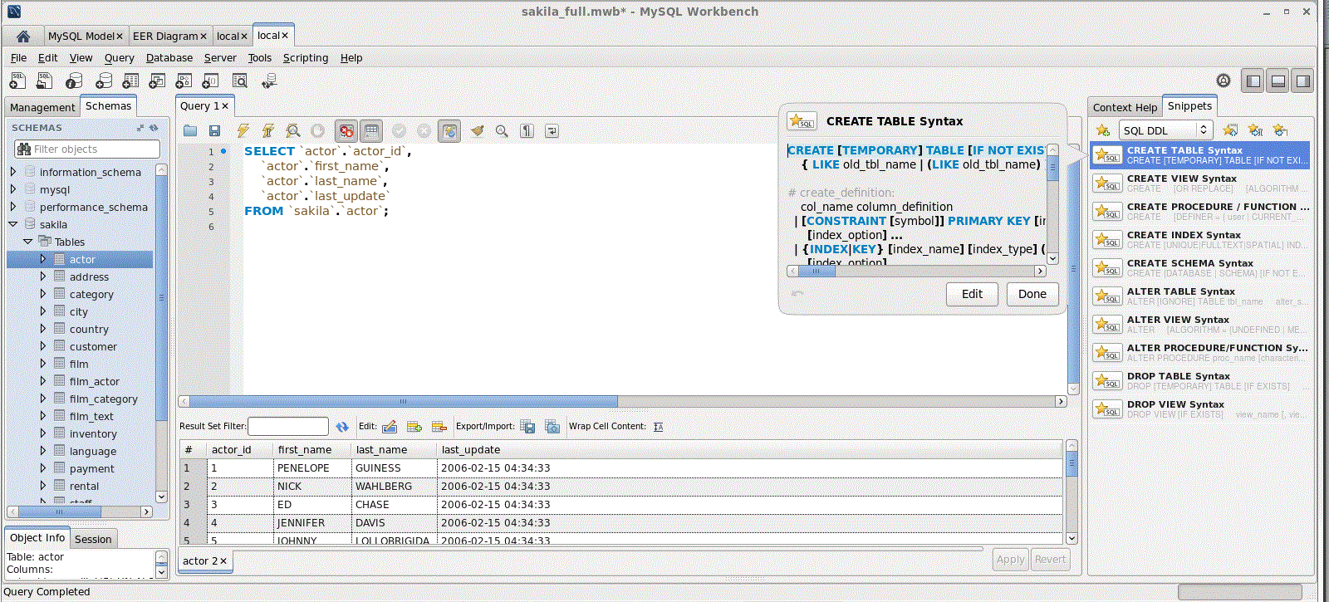
DATABASE CODE

Slide 7
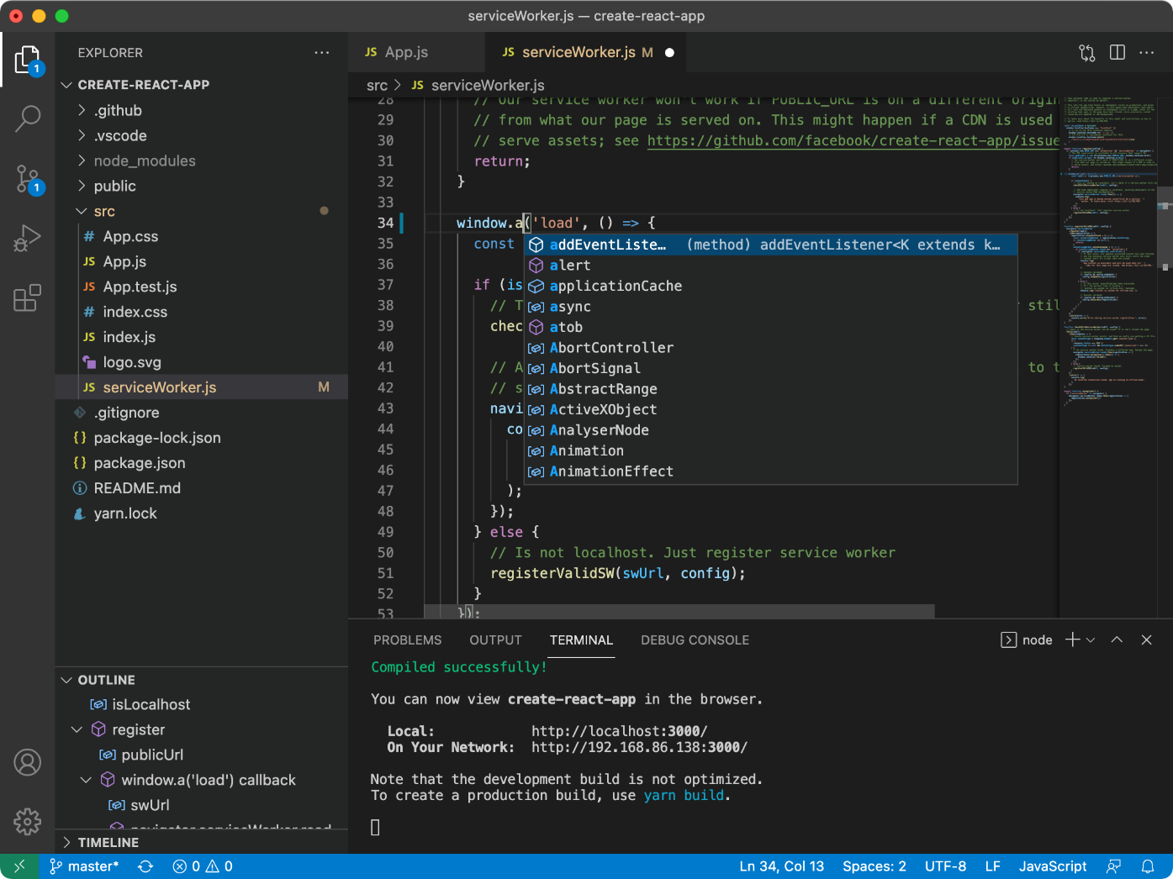
ANGULAR CODE

Slide 8

HOME PAGE

Slide 9

GITHUB LINK

Slide 10


